Slide 1
Software Engineering Presentation
By: Karl Miller, Tadhg Savage and Aisha Ntuli

Slide 2
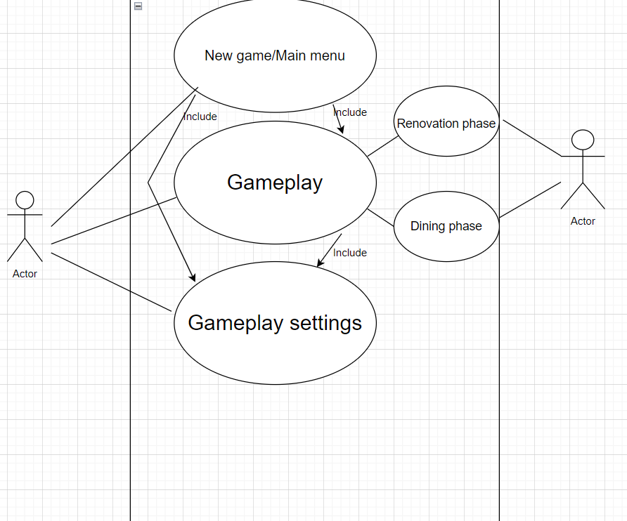
:Use-case diagram
: The actor on the left is the player of the game and the actor on the right is the GSManager
:The GsManager takes care of the game related things like swapping the game phases between dining and renovation
:The include statements mean that certain use cases include the functionality of others.

Slide 3
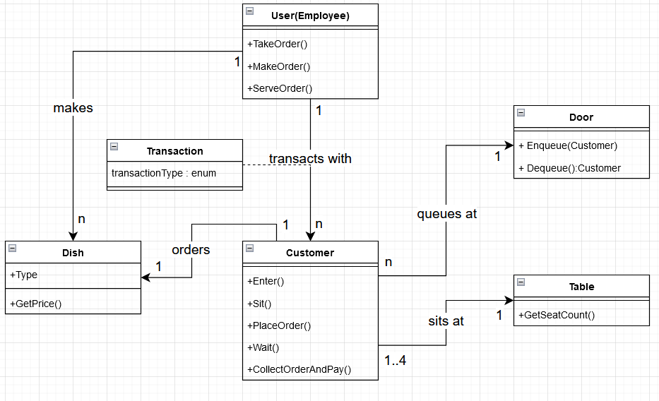
:Class Diagram :The customer interacts with all the available objects firstly it waits at the door for an available table, once there is an available seat the customer will sit down and begin to order an available dish. :The player will correspond accordingly to the needs of the customer, the customer will leave after they finish eating. :More than one customer can enter and leave the restaurant at a time as such they will need a table to the corresponding size to match.

Slide 4
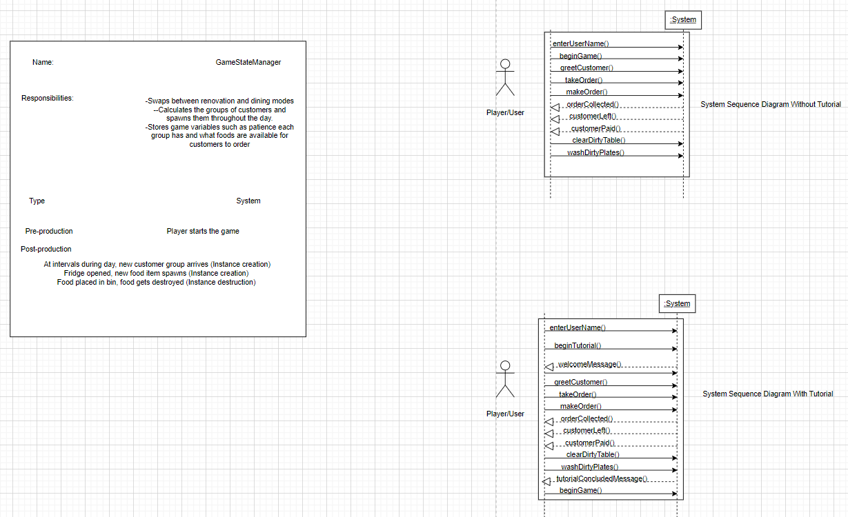
:system sequence diagram :A sequence diagram describes an interaction by focusing on the sequence of messages enchanged and their corresponding event-occurrences on lifelines. :The sequence diagram highlights the exchange of messages between the player and the GameState manager in a sequential order. :The diagram states a nice example of how the player should react when a customer enters and once the player acts accordingly the customer will leave.

Slide 5
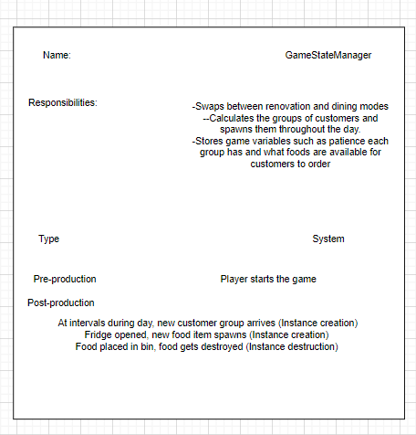
:Contracts help define system behaviour; they describe the effects of operations upon the system. :A contract is a document that describes what each system operation commits to achieve. :The GameState magager intends to create and destroy instances such as making customers arrive to the restaurant.

Slide 6
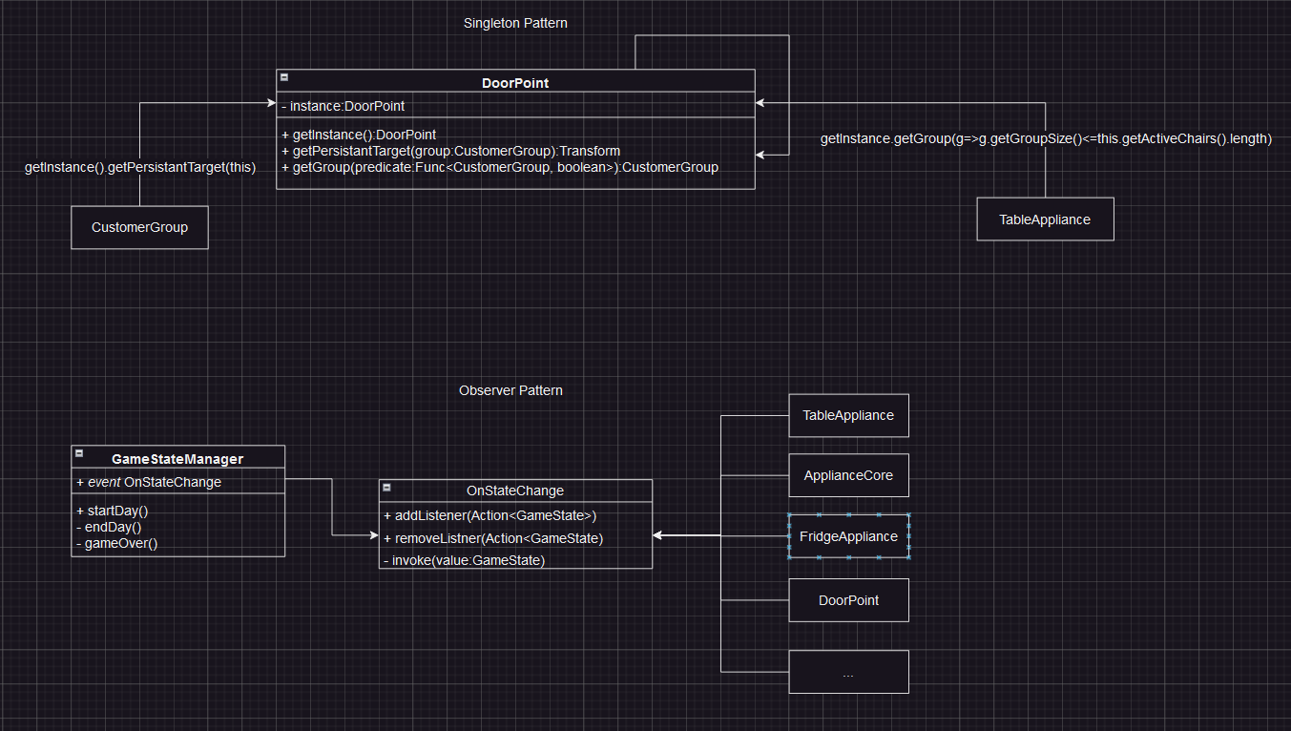
;Communication diagram :Communication diagrams are best used for describing communication between objects or patterns commonly executing a system operation :The Singleton pattern was used to express the communication between the Customer(ai) and when they wait or walk into the restaurant. :The Observer patter was used to show how the GameState Manager works accordingly to the game phases and changes things based on the phase.

